Slide 1
Chapter 1
Introduction to HTML (cont)
Lectured by:
Nguyễn Hữu Hiếu

Slide 2
New Doctype
<!DOCTYPE html>
Works now in all browsers for “standards mode” start using it!
https://www.w3schools.com/tags/tag_doctype.asp

Slide 3
THE EVOLUTION OF HTML
HTML 4
1997
XHTML
2000
HTML5
Work In Progress
Had some presentational elements
Written in XML
Presentational elements removed
Can be used today
Notes:
Explain: There are three different types of list...
1. Ordered - The order of list items is important
2. Unordered - The order of list items is not important
3. Definition - To explain the meaning of terms

Slide 4
- Recent versions:
- HTML 4.0 – 1997
- HTML 4.01 - 1999 - A cleanup of 4.0
- XHTML 1.0 - 2000
- Just 4.01 defined using XML, instead of SGML
- XHTML 1.1 – 2001
- Modularized 1.0, and drops frames
- W3C worked on XHTML 2.0; WHAT worked on a new version of HTML
- In 2009, XHTML 2.0 was stopped; W3C took over development of HTML5

Slide 5
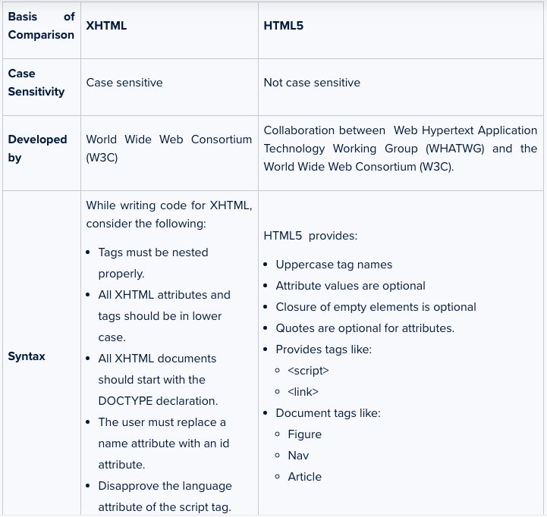

Slide 6
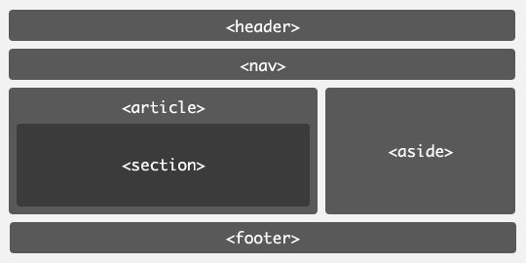
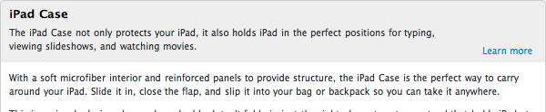
Content Elements
<header>
<nav>
<article>
<aside>
<section>
<footer>
<summary>
<details>

Slide 7
Audio and Video
Native Audio Element
<audio>
<source src="music.oga" type="audio/ogg">
<source src="music.mp3" type="audio/mpeg">
</audio>
Native Video Element
<video src="video.ogv" controls poster="poster.jpg" width="320" height="240">
<a href="video.ogv">Download movie</a>
</video>

Slide 8
Audio and Video
Making your own video controls
<video src="video.ogg" id="video"></video>
<script>
var video = document.getElementById("video");
</script>
<p>
<button onclick="video.play();">Play</button>
<button onclick="video.pause();">Pause</button>
<button onclick="video.currentTime = 0;">Rewind</button>
</p>

Slide 9


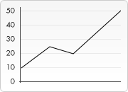
Canvas - 2d Drawing
function draw() {
var ctx = document.getElementById('canvas').getContext('2d');
var img = new Image();
img.onload = function(){
ctx.drawImage(img,0,0);
ctx.beginPath();
ctx.moveTo(30,96);
ctx.lineTo(70,66);
ctx.lineTo(103,76);
ctx.lineTo(170,15);
ctx.stroke();
}
img.src = 'images/backdrop.png';
}
https://developer.mozilla.org/en/Canvas_tutorial

Slide 10
New Form Elements
New Input Types
tel, search, url, email, datetime, date, month, week, time, datetime-local, number, range, color
New Elements
<datalist>
<meter>
<progress>
<output>

Slide 11
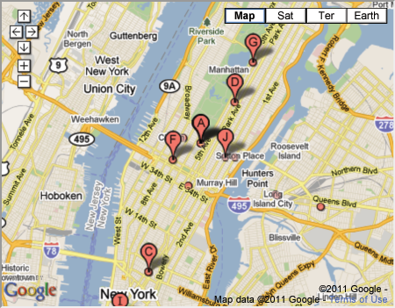
Iframes
<iframe width="450" height="350"
src="http://maps.google.co.uk/maps?
q=moma+new+york&amp;output=embed"
frameborder="0"
scrolling="0">
</iframe>
Notes:
Explain: An iframe acts like it is cutting a window into the current web page. This allows you to see another web page behind it. A common use for iframes is including a Google Map in a page.

Slide 12
INFORMATION ABOUT YOUR PAGES
<head>
<title>Essay</title>
<meta name="description"
content="An essay on installation art" />
<meta name="keywords"
content="essay,installation art" />
<meta http-equiv=”author”
content="Jon Duckett" />
<meta charset = ″utf-8″ />
</head>
Notes:
Explain: Meta tags provide information about the page. Note that the first pair here includes name and content attributes. The second pair includes http-equiv and content attributes.

Slide 13
Tài Liệu Tham Khảo
[1] Unix Network Programming, Vol. 1, Third Edition, The Sockets Networking API, W. Richard Stevens, Bill Fenner, Andrew M. Rudoff, Addison Wesley, 2003

